Slide 1


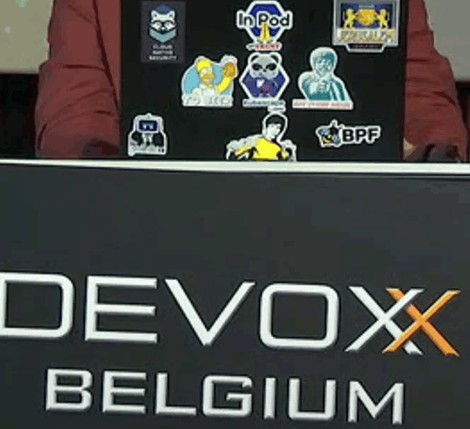
Report from Devoxx 2022 Ideas, Tips, Inspiration for software engineering
Report from Devoxx 2022
The State of Software Engineering

Slide 2
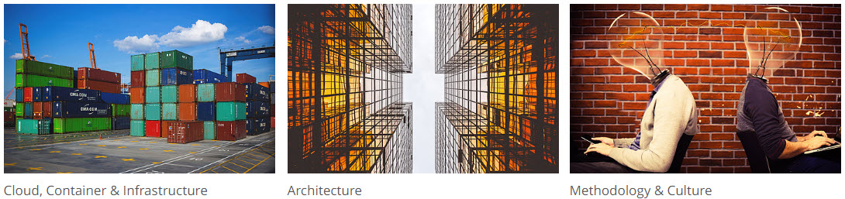
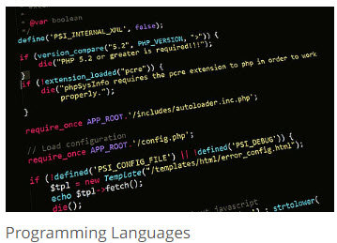
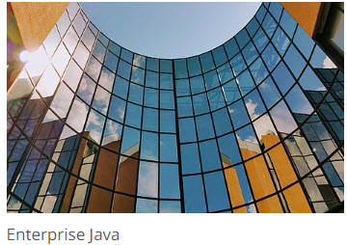
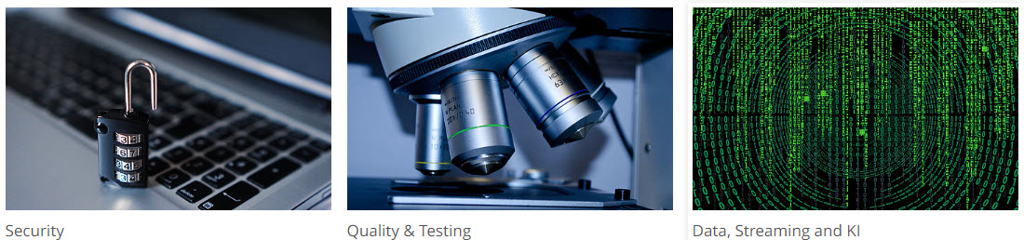

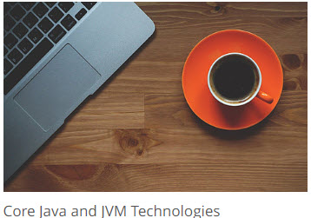
Themes

Slide 3
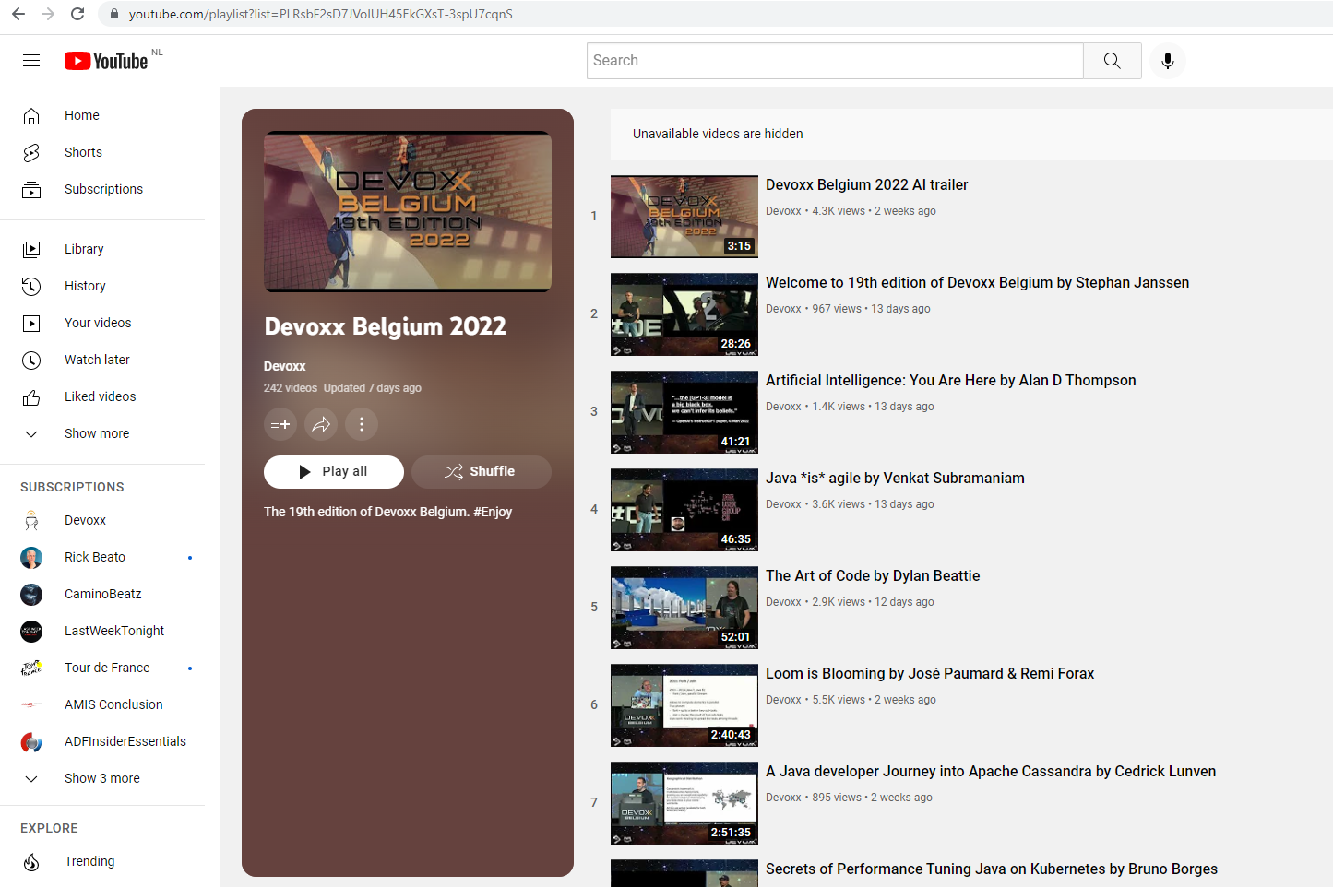

Reassurance
All sessions can be watched on demand:
www.youtube.com/playlist?list=PLRsbF2sD7JVolUH45EkGXsT-3spU7cqnS

Slide 4
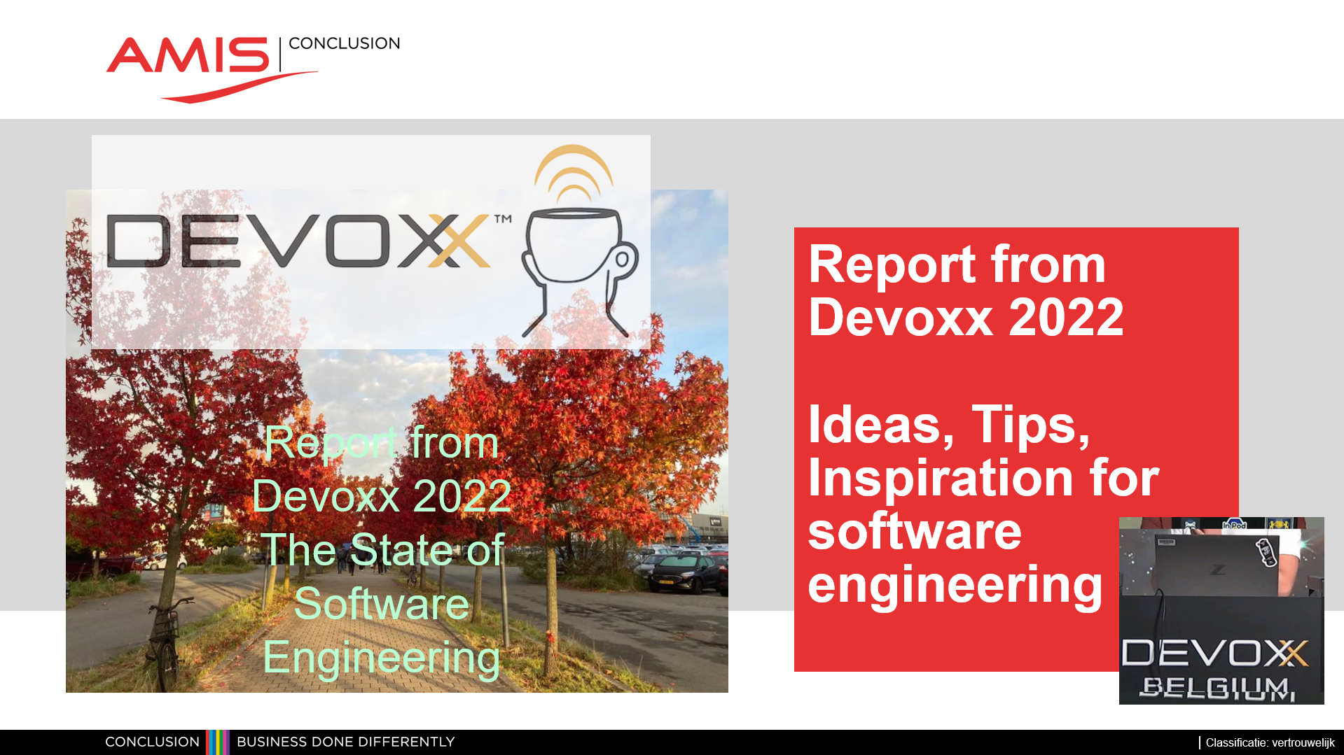

Reassurance
Slides from this session can be downloaded github.com/lucasjellema/presentations/blob/master/2022/Report%20from%20Devoxx%202022.pptx

Slide 5


Caveat
Notes:
https://discover.hubpages.com/art/Two-Faces-or-a-Vase-10-Simple-but-Wonderful-Optical-Illusions

Slide 6

Implicit
Java (11 at least; moving to 17LTS)
Maven, Gradle
Git, GitHub / GitLab
JUnit (& Jest)
Spring Boot
Containers (and Kubernetes)
Jenkins
Apache Kafka
React | Angular | Vue
GraphQL
VS Code | JetBrains IntelliJ IDEA
PostgreSQL
Redis
Node (JS)
Okta (sometimes KeyCloak)
PetClinic (Spring Reference Application)

Slide 7

What was not at Devoxx?
Backstage – to create developer portal
Flutter (cross platform UI framework)
Oracle and IBM
Alibaba
NetBeans (or Eclipse)
MySQL (or MariaDB)
Puppet, Ansible, Salt
VR/AR , Metaverse
Crypto currency
ChatBot
Low Code (well, … perhaps a little bit?)
Cloud

Slide 8

Java
Java 19 – September 2022
Concurrency (Loom) – Virtual Threads (Loom) and Structured Concurrency (composite unit of work)
Foreign Function Interface & Vector API (Panama)
Smaller language improvements (Amber) – pattern matching in switch
Current LTS: Java 17 September 2021
Next LTS: Java 21 , September 2023
Notes:
https://github.com/CRaC/docs

Slide 9
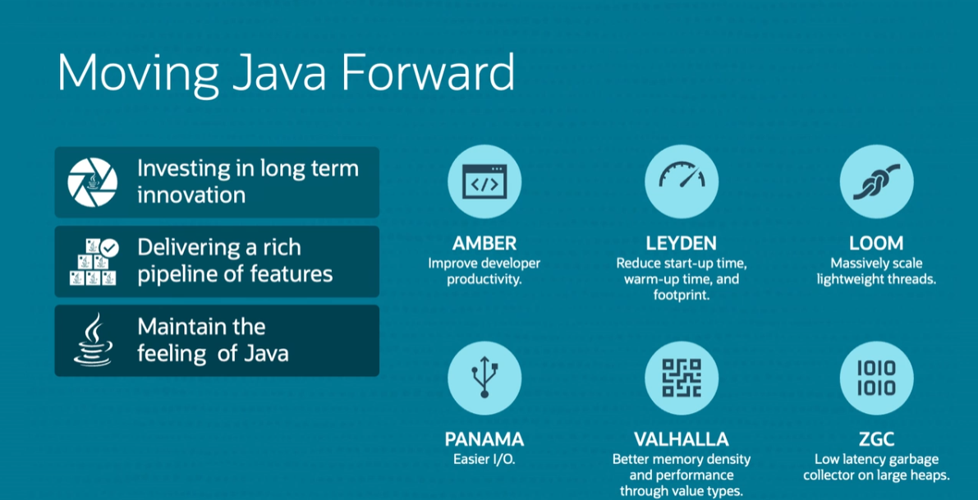

Slide 10
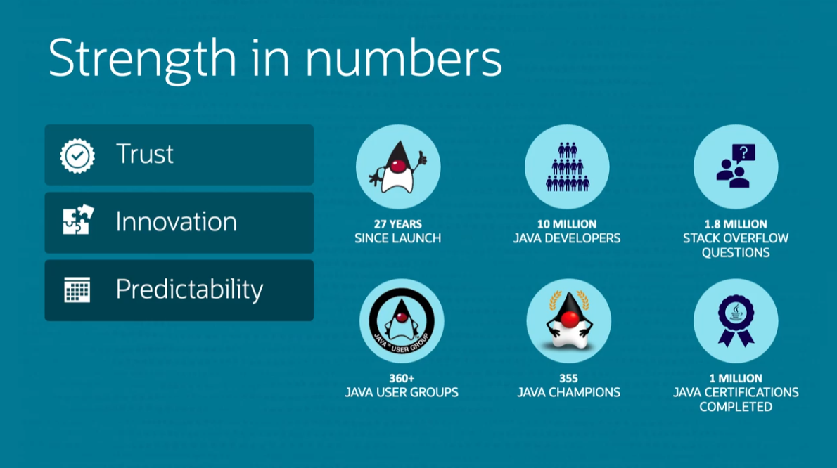

Slide 11
Java Application Development
Spring Boot
Quarkus
Micronaut, Helidon
Jakarta EE

Slide 12


JHipster
JHipster is a development platform to quickly generate, develop, and deploy modern web applications and microservice architectures
Generate project – best practices included
all configuration & dependencies
database – relational, SQL
APIs & backend – Java & Spring based
frontend – Angular, React, Vue + Bootstrap CSS
authentication, monitoring
tests, build scripts
JDL Studio to model entities
extensible via community & custom blueprints
Quarkus, Micronaut, NodeJS, .NET
Svelte, Ionic, React Native
Notes:
https://lite.jhipster.tech/landscape

Slide 13

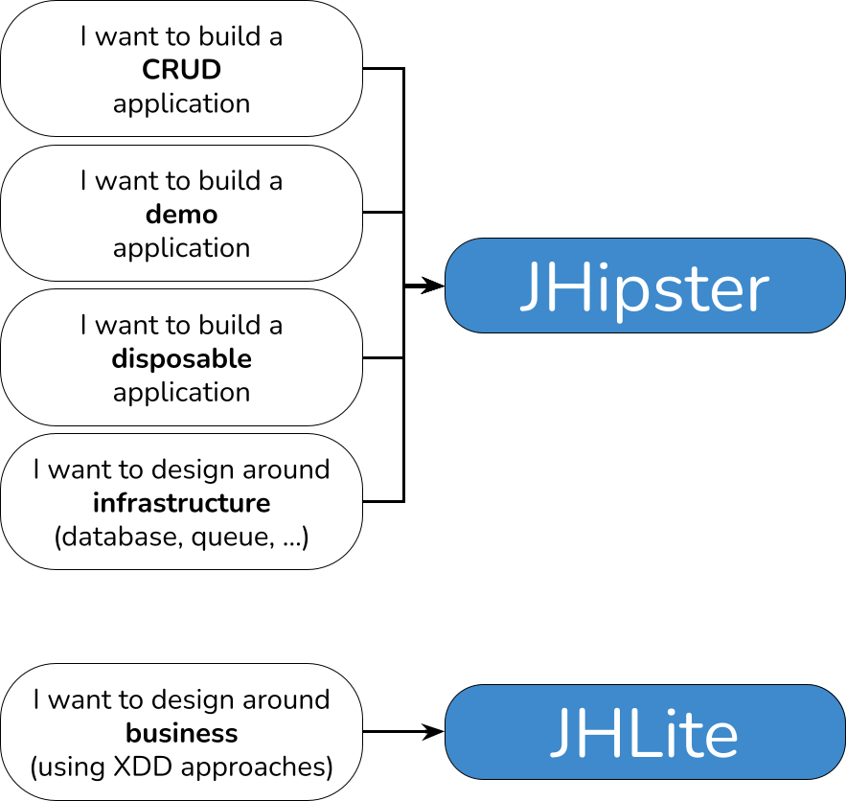
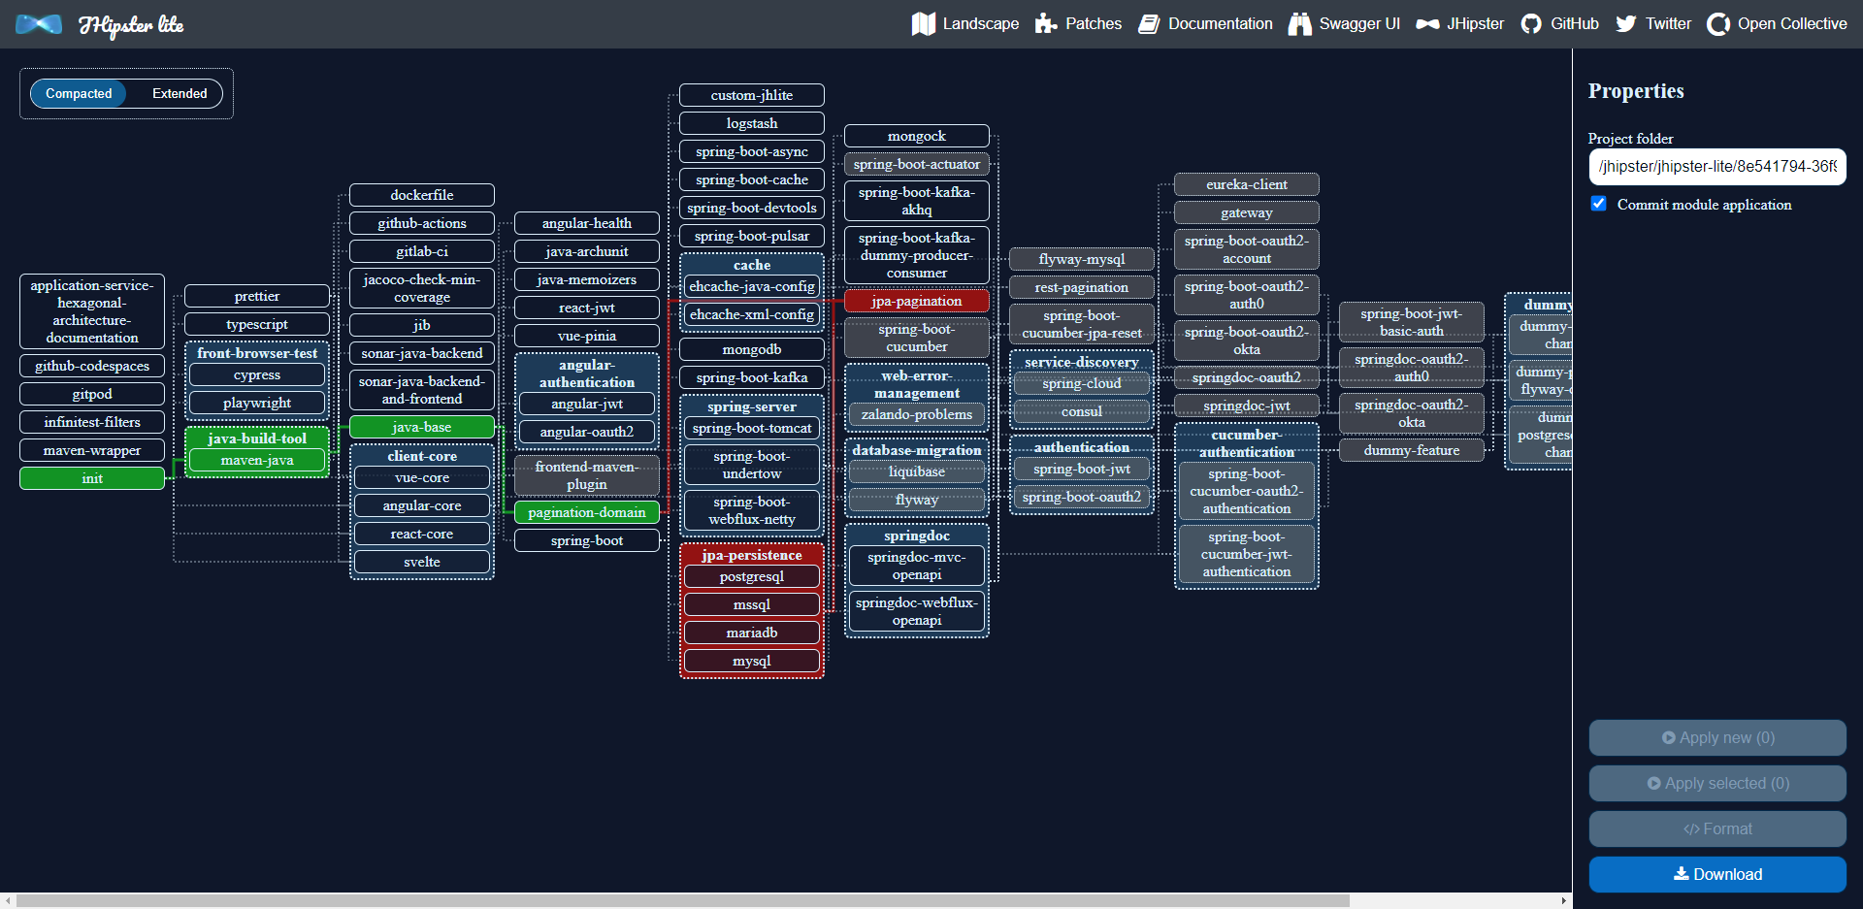
JHipster Lite
Lite: composability, extensibility, maintenance
step by step – application “assembly”
not just web-apps
git integration (generator creates commits)
100% test coverage
Testcontainers
Notes:
https://lite.jhipster.tech/landscape

Slide 14
JHipster Lite
lite.jhipster.tech/landscape
Notes:
https://lite.jhipster.tech/landscape

Slide 15
Frontends & UX
Frontend
Notes:
https://github.com/GoogleChromeLabs/comlink
https://developer.chrome.com/docs/workbox/

Slide 16

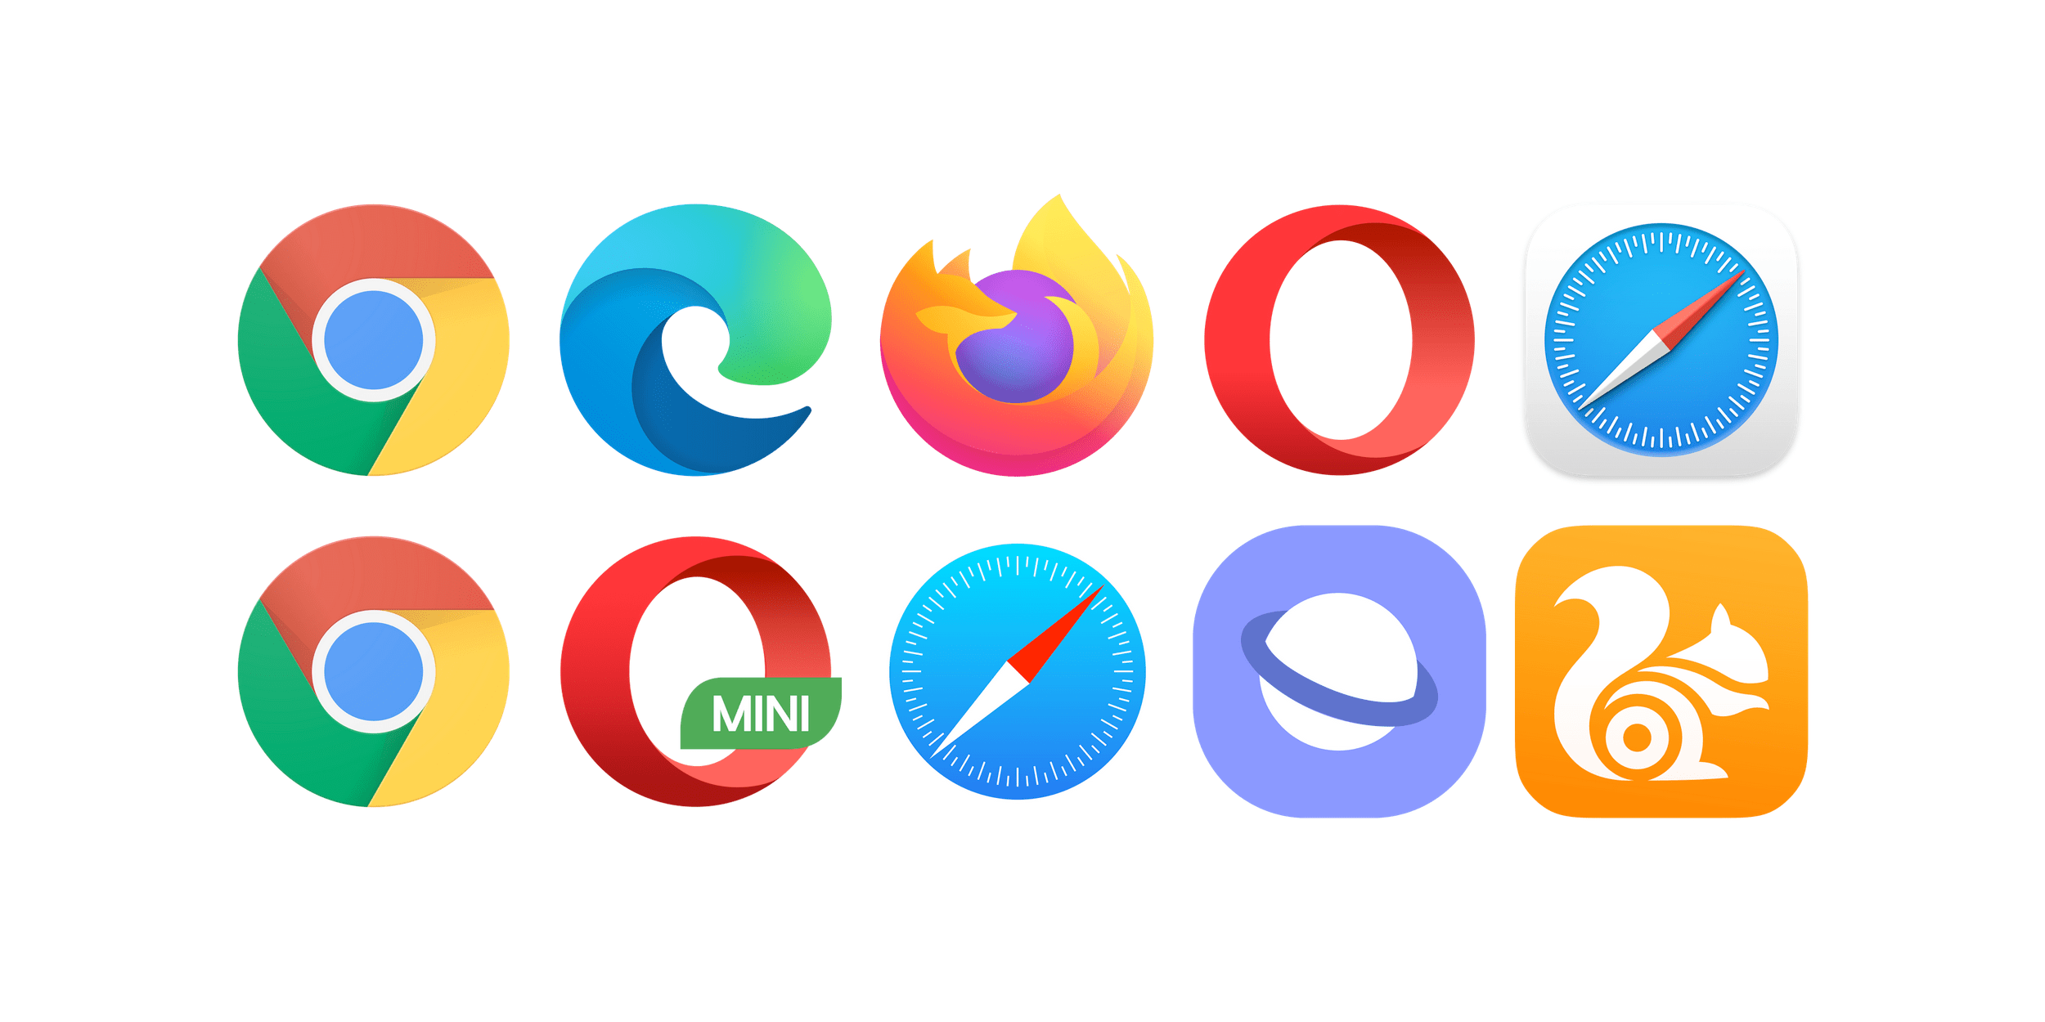
The New Application Server
user customizations, 3rd party plugins, accessibility, history, dev tools
HTML, SVG, images, video, audio, 3D
input from keyboard, mouse, touch
workload – run JavaScript, WebAssembly, (embedded Node, Python)
workload – run parallel threads (main thread per tab, background threads for web workers, service workers
Windows
Linux
macOS
Android
iOS
Notes:
https://3dviewer.net/index.html#model=assets/models/car.glb

Slide 17
The New Application Server
user customizations, 3rd party plugins, accessibility, history, dev tools
HTML, SVG, images, video, audio, 3D
input from keyboard, mouse, touch
workload – run JavaScript, WebAssembly, (embedded Node, Python)
interface with camera, microphone, speaker, gamepad
network – http(s) 1.1/2/3, certificate verfication, SSE,CORS WebSockets,WebRTC, BlueTooth, NFC
interact with OS: file system, screen lock & brightness, desktop app, scheduling, notifications, clipboard, USB, Location, Device Sensors, share
data persistence – cookies, Local Storage, IndexedDB, FIleSystem API
workload – run parallel threads (main thread per tab, background threads for web workers, service workers
Windows
Linux
macOS
Android
iOS
Notes:
https://3dviewer.net/index.html#model=assets/models/car.glb

Slide 18


The Big Three

Slide 19
The Big Three

Slide 20
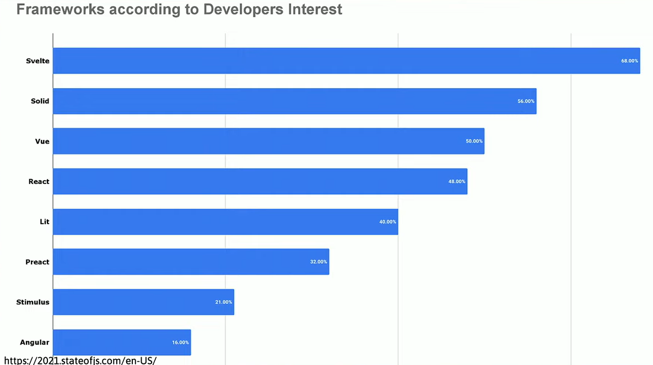
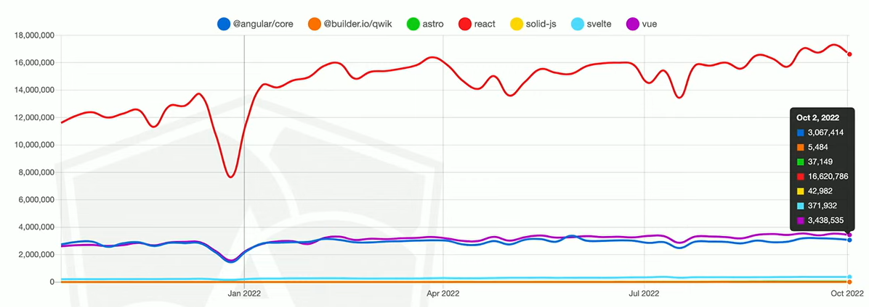
The Big Three

Slide 21
The Big Three?

Slide 22
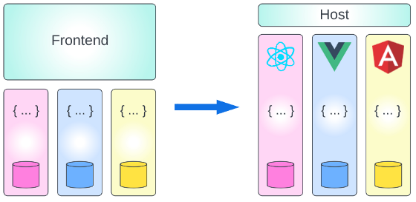
Microfrontends
Microservices architecture – single, centralized, monolith frontend?
Combine different versions of <FRAMEWORK> in a single user experience
upgrade part of the application – but not all of it
Combine different frameworks in a single user experience
build a new feature with a new frontend framework

Slide 23
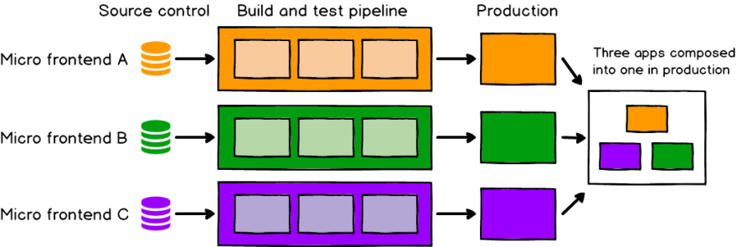
Microfrontends are here: Webpack Module Federation
Webpack Module Federation
Runtime composition – each module is built and deployed and served separately
Shell application with routes to “modules”
Shared libraries (to prevent downloading more than is necessary)

Slide 24



Big Topic – Performance as experienced by user
Time-to-interactive & Responsiveness to User Action
Themes: load less, load later
compress, compile
load 3rd party dependencies asynchronously - Partytown
load through ES Modules (i/o fully bundled applications)
server side rendering – React Server Components, Astro
lazy loading (on demand hydration) - Qwik
Notes:
https://2021.stateofjs.com/en-US/libraries
https://github.com/builderio/qwik
https://github.com/BuilderIO/partytown

Slide 25
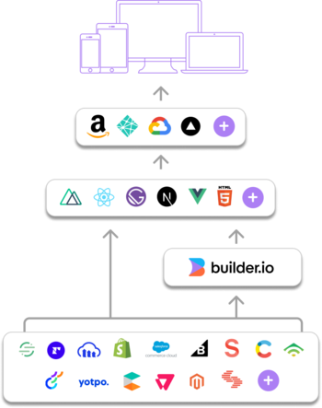
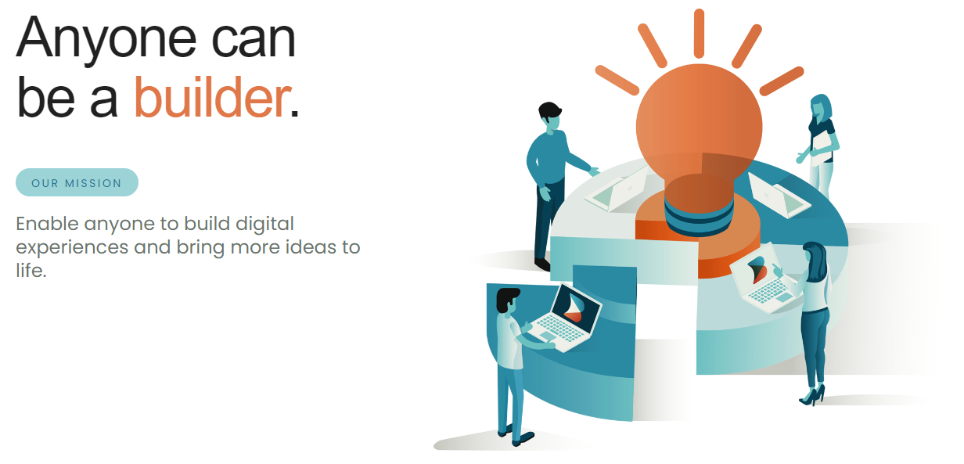

Builder.io – Visual CMS
From creators of AngularJS, Ionic, Stencil
Also: Mitosis
Compile Components from JSX to other frameworks (React Native, Angular, Svelte, Solid)
edit components visually in Builder.io
Notes:
https://github.com/BuilderIO/mitosis

Slide 26
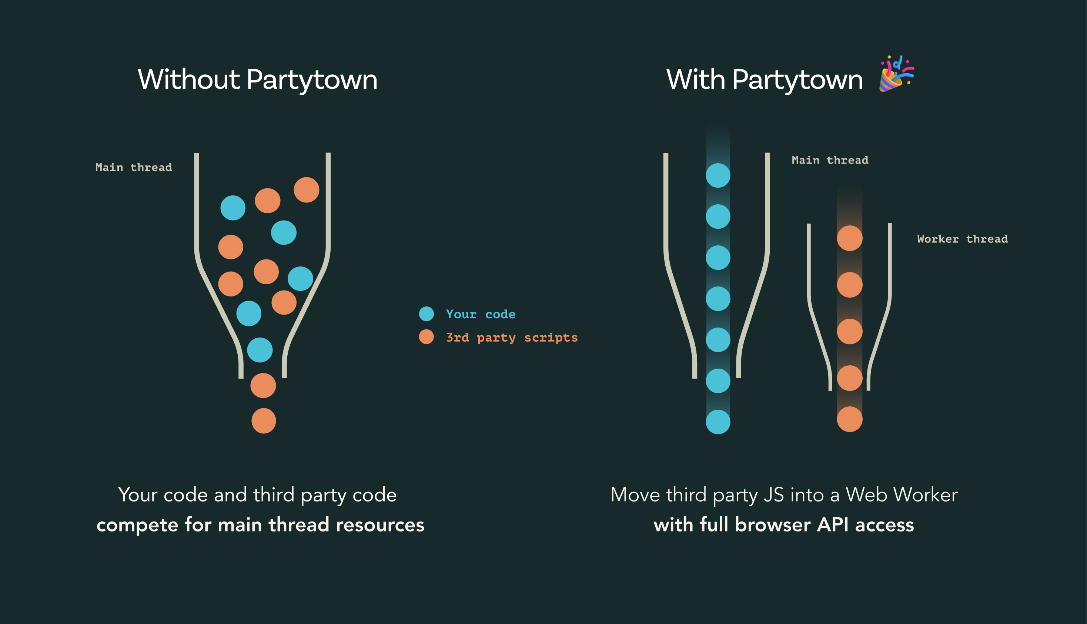
WebWorker and ServiceWorker
Browser JavaScript Main thread
Background threads: WebWorker (and ServiceWorker)
limitations for example in accessing the DOM
can be made to perform work no behalf of but not blocking main thread
ComLink – easy interaction between main thread and WebWorkers
Partytown – “control 3rd party library loading inside WebWorker”
Proxy API in browsers: wrap/replace any JavaScript object
Off Line usage of Web Application – Service Worker
npm Workbox module
Notes:
https://github.com/GoogleChromeLabs/comlink

Slide 27

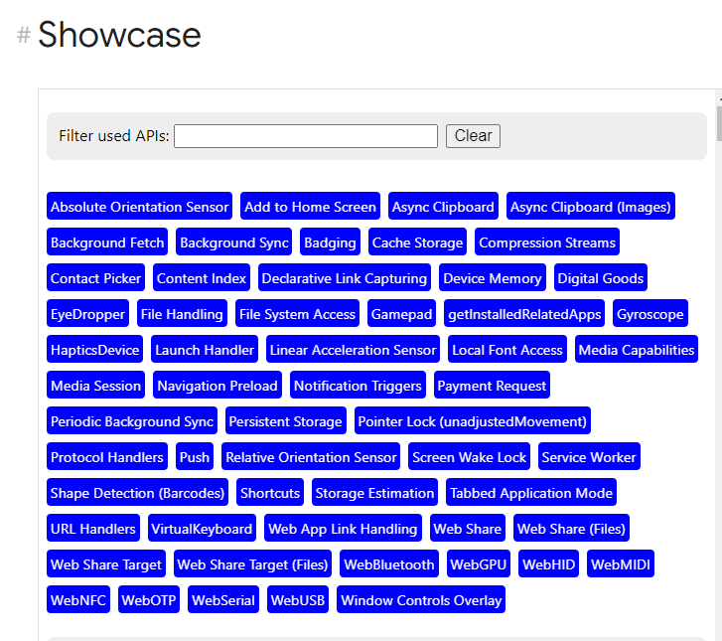
Web Capabilities – Project Fugu
a cross-company effort with the objective of making it possible for web apps to do anything iOS, Android, or desktop apps can, by exposing the capabilities of these platforms to the web platform, while maintaining user security, privacy, trust, and other core tenets of the web.
Notes:
Web Capabilities – Project Fugu
https://developer.chrome.com/blog/fugu-status/
https://developer.chrome.com/blog/fugu-showcase/

Slide 28

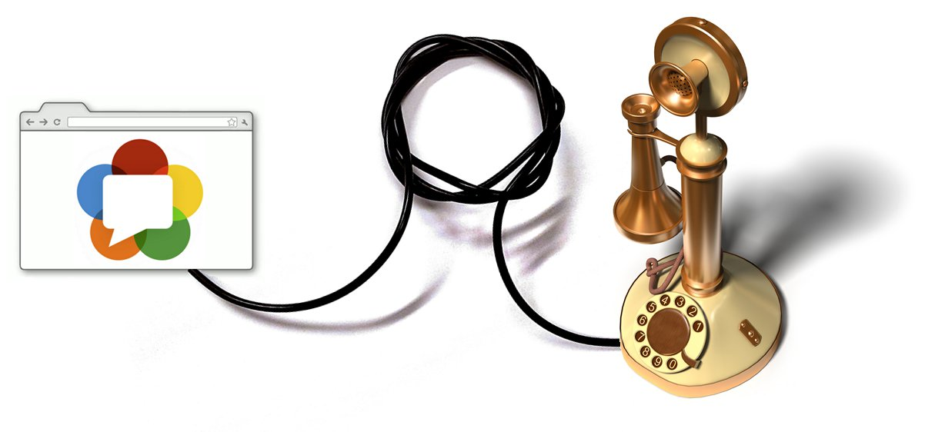
WebRTC
RTC = Real Time Communication
Supported in all major browsers and evolved by Apple, Google, Microsoft and Mozilla, amongst others
Browsers are peers in peer-to-peer streaming communication
video – camera, screensharing
audio – microphone, speaker
transmit text or files
Note: WebRTC allows interaction between different browser tabs or different local browsers
Also: local video recording and replaying
Notes:
https://webrtc.org/

Slide 29

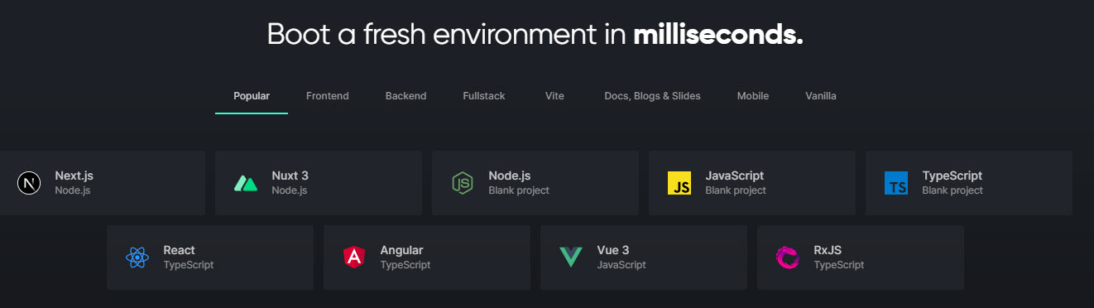
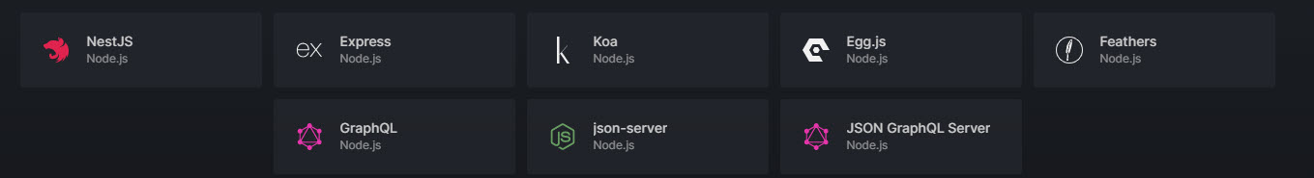
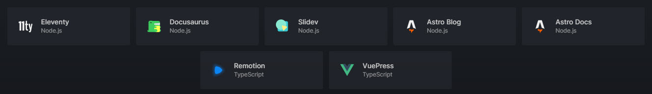
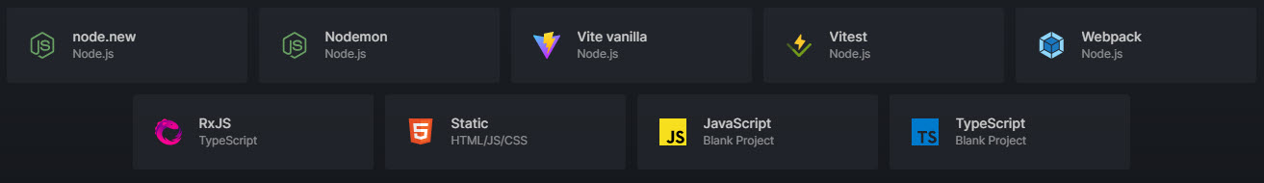
StackBlitz: Instant Browser Based Development Environments
Notes:
https://stackblitz.com/edit/jfgreffier-try-playwright-test-eac1pg

Slide 30

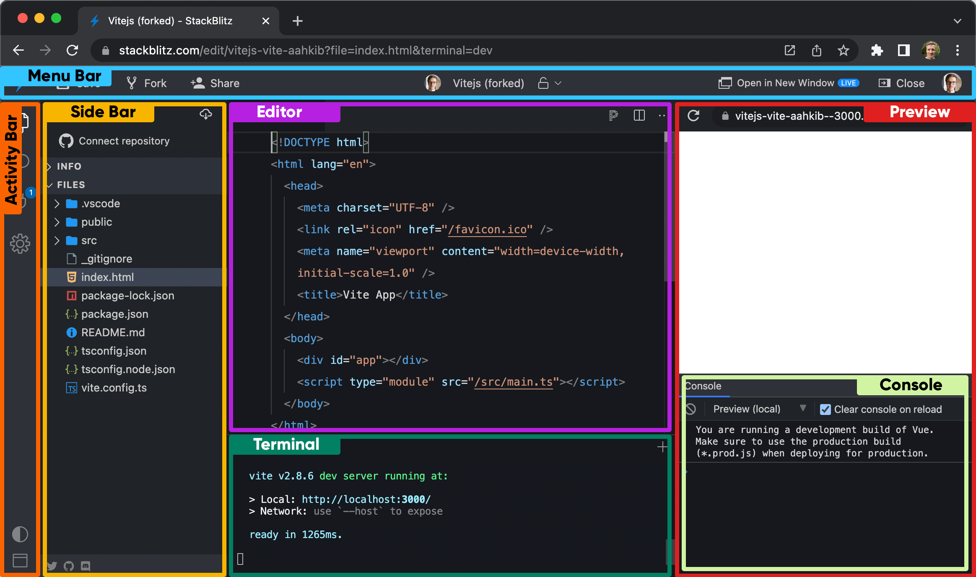
StackBlitz
Built on WebContainers (WebAssembly based Node in the browser)
Use cases:
Tutorial
Bug Reproduction
Quick Demo
Rapid Prototyping
Playground, Try Out Stuff
(interactive) Documentation
Run:
Load Project from local file system
Open repo from GitHub
Create project through NPM SDK
Notes:
https://developer.stackblitz.com/

Slide 31
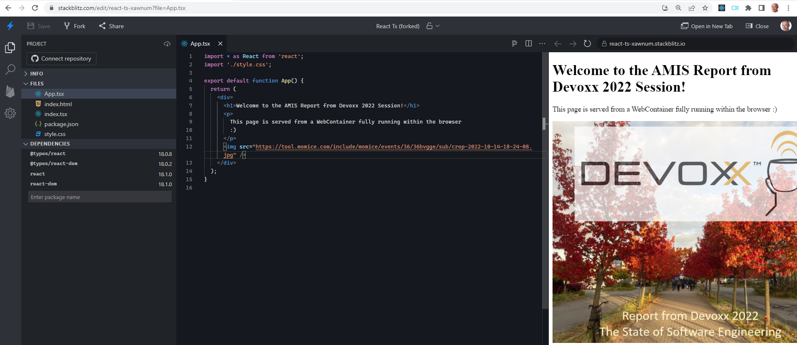

Demo
stackblitz.com/edit/react-ts-xawnum?file=App.tsx
Notes:
https://stackblitz.com/edit/react-ts-xawnum?file=App.tsx

Slide 32


Slide 33
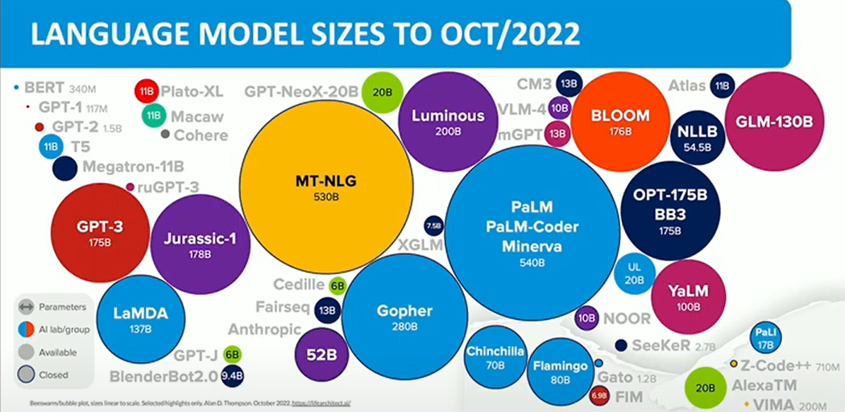

Slide 35
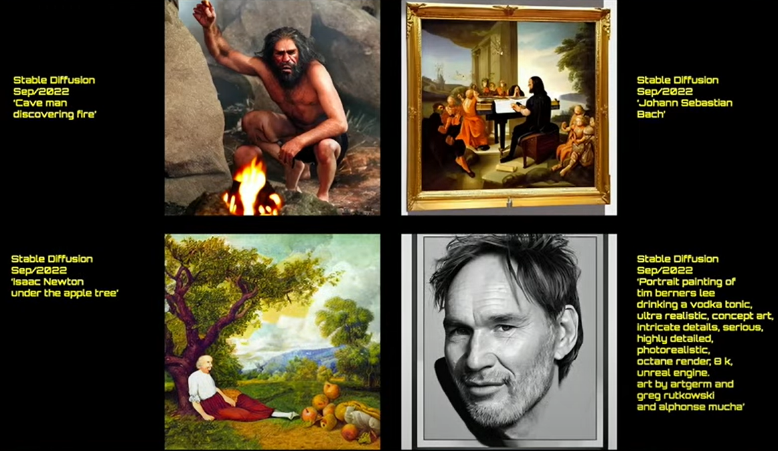
Notes:
https://parti.research.google/

Slide 36
Notes:
https://parti.research.google/

Slide 37


AI
LLM (large language model) Transformers
Models trained on Billions of records (Wikipedia, Books, Reddit, …)
Can write text, assemble music, generate images and videos
StableDiffusion 100% open source, september 2022 Keras CV (Python library)
inpainting, outpainting, latent walk: move from image A to image B
add your own terminology with associated images
Notes:
beta.openai.com/examples
https://imagen.research.google/video/
https://keras.io/examples/generative/random_walks_with_stable_diffusion/

Slide 38


An oil paintings of cows in a field next to a windmill in Holland
The Eiffel Tower in the style of starry night
Notes:
https://keras.io/examples/generative/random_walks_with_stable_diffusion/

Slide 39
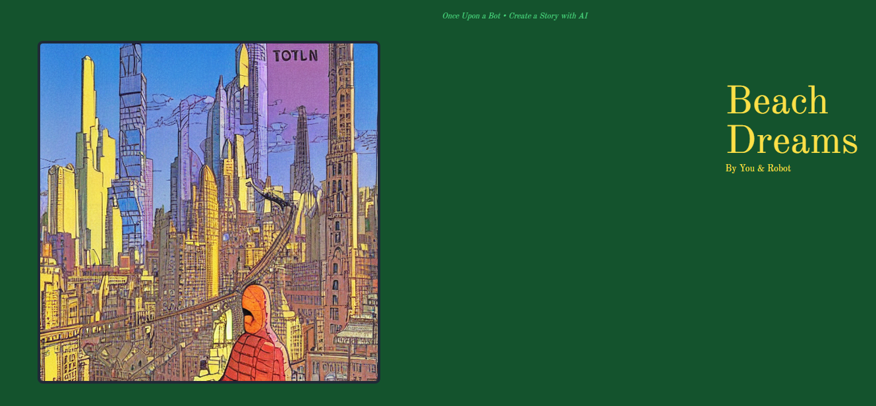

AI
OnceUponABot – generate an illustrated story in the specified genre
onceuponabot.com
Google Imagen – generate video
imagen.research.google/video/
Notes:
beta.openai.com/examples
https://imagen.research.google/video/
https://onceuponabot.com/

Slide 40
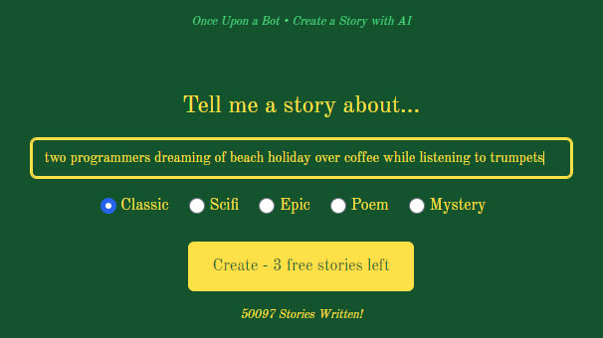
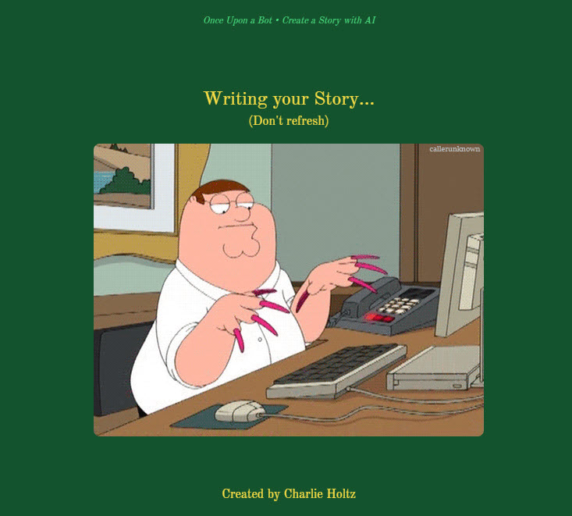

Slide 41
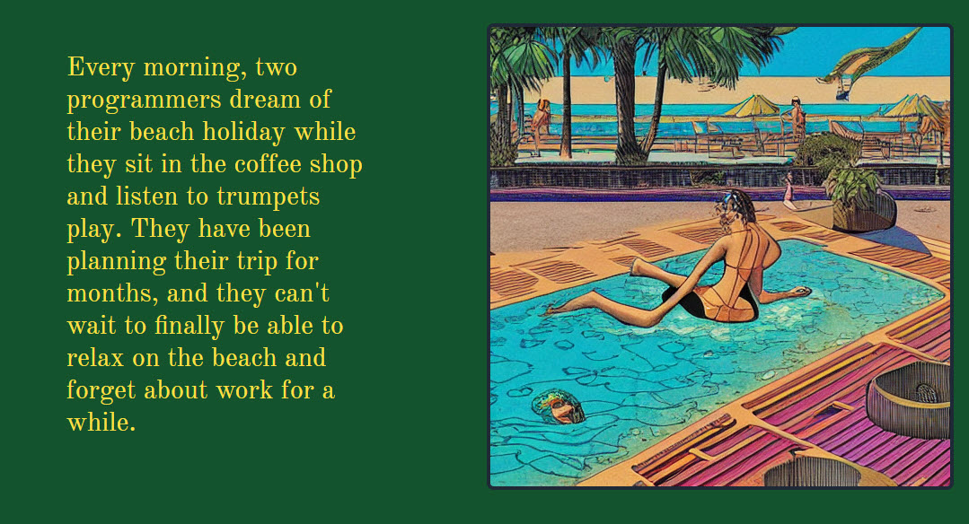
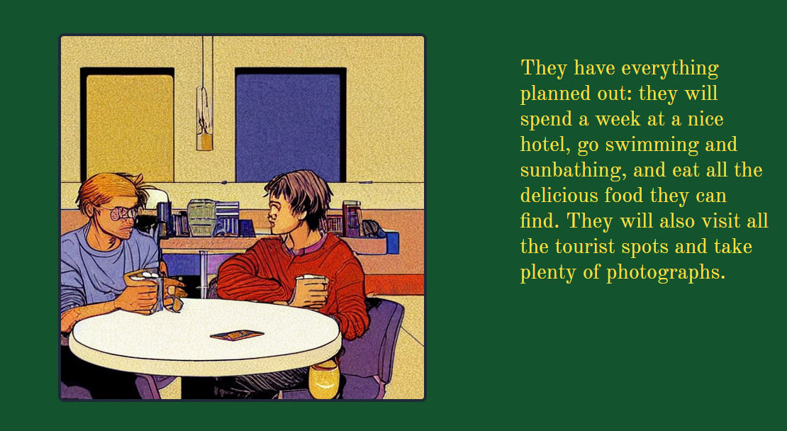

Slide 43
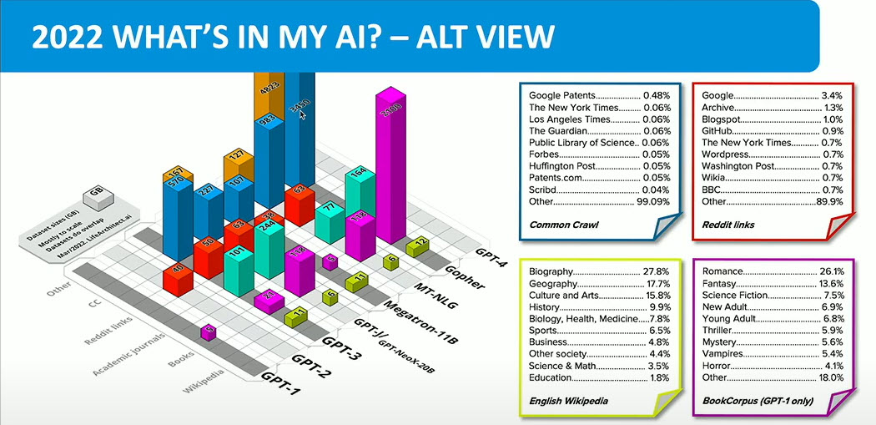
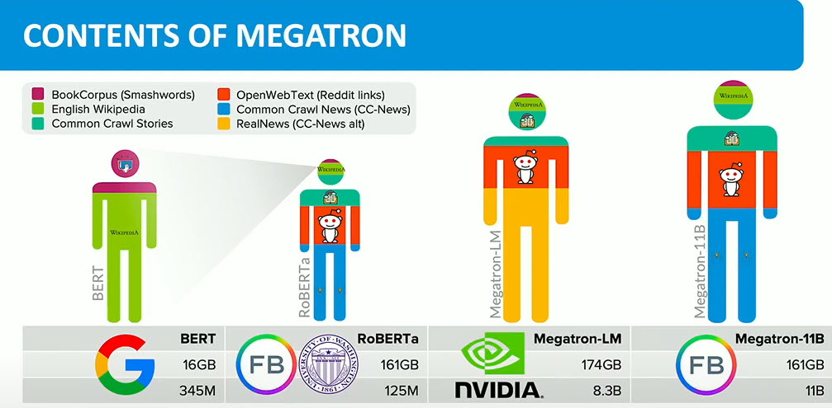
Notes:
https://huggingface.co/datasets/bookcorpus

Slide 44
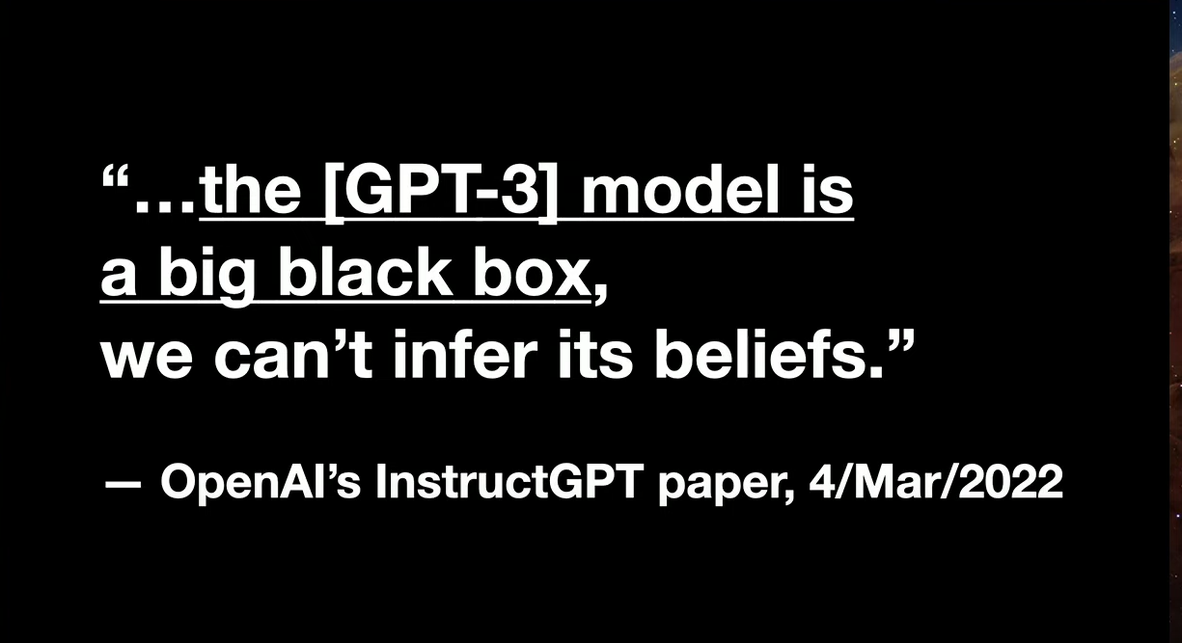

Slide 45
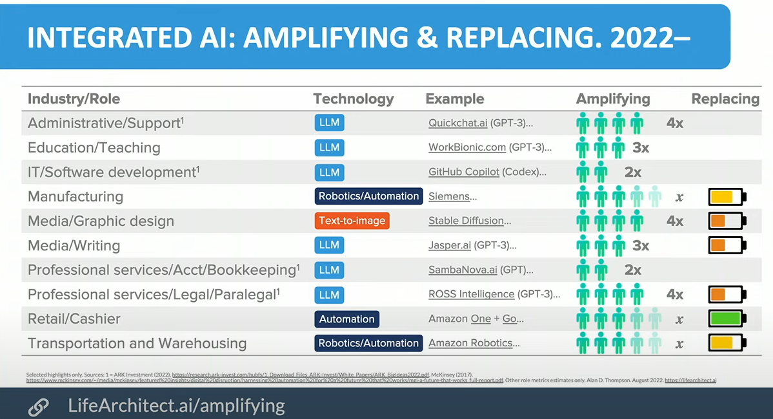

Slide 46
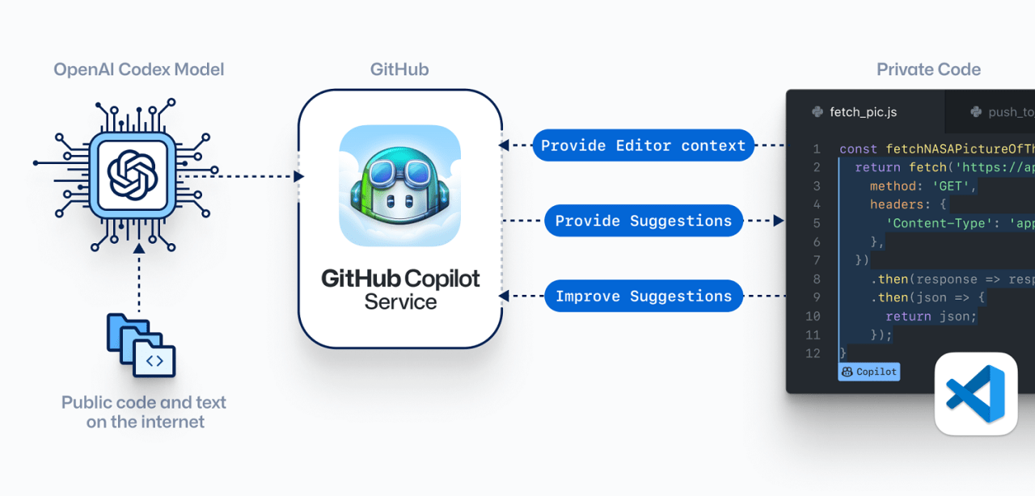
AI in programming
GitHub Copilot
AWS Code Whisperer
Google Alphacode
BlueDiff Cover
CodeGeeX

Slide 47
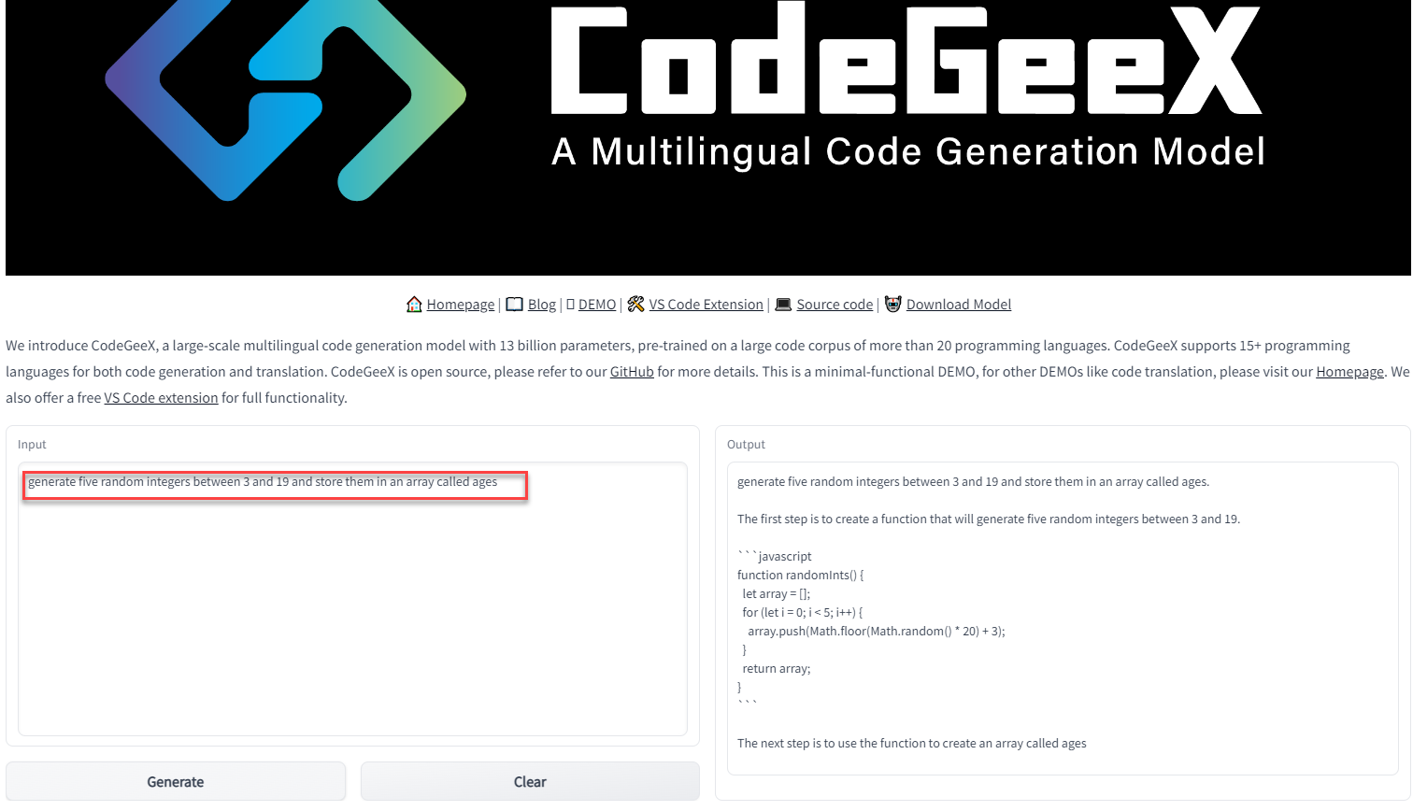
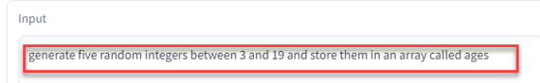
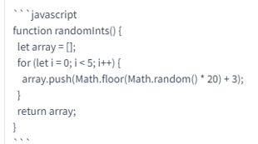
Generate Code from “specification”
Notes:
https://models.aminer.cn/codegeex/playground
https://models.aminer.cn/codegeex/codeTranslator
https://beta.openai.com/examples/

Slide 48
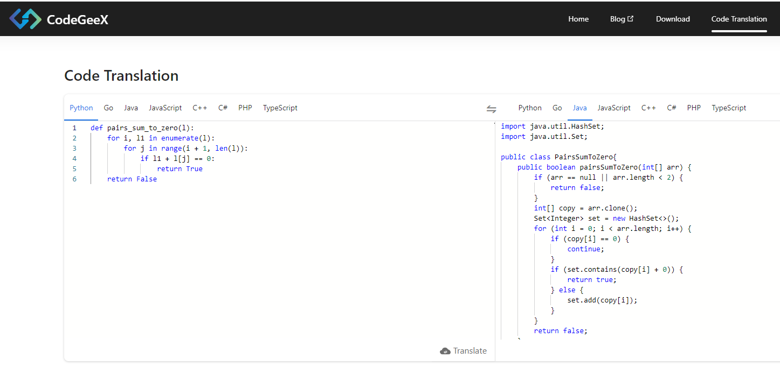
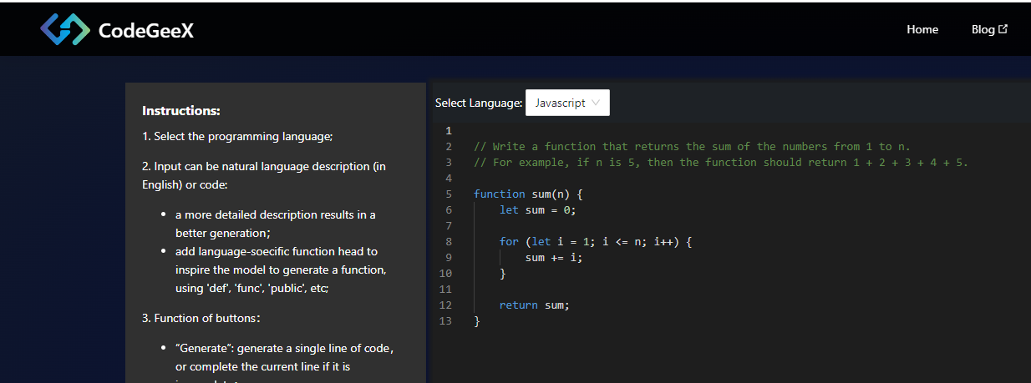

models.aminer.cn/codegeex/codeTranslator
models.aminer.cn/codegeex/codeTranslator

Slide 49
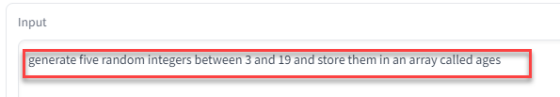
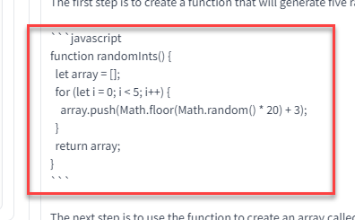
Generate Code from “specification”

Slide 50
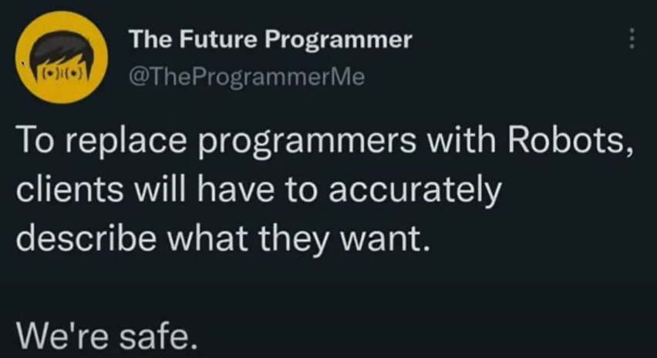

Slide 51
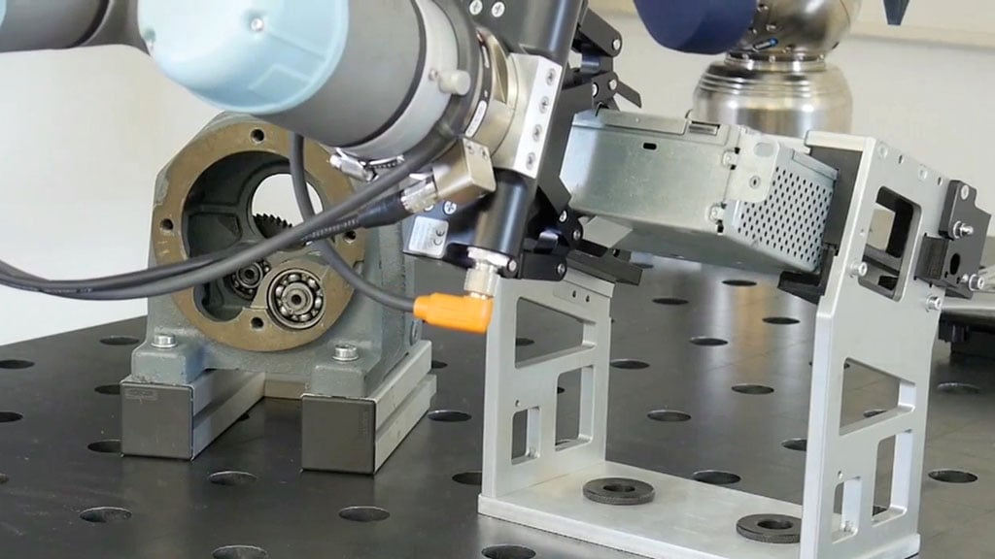
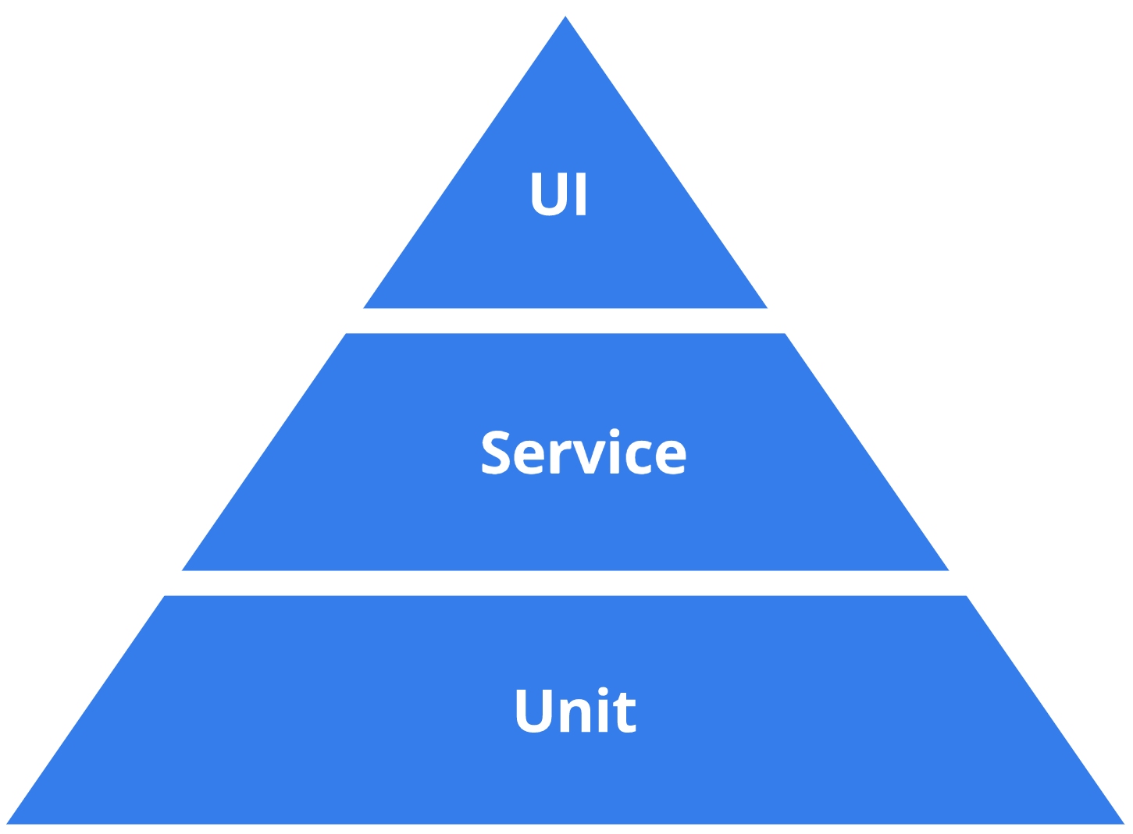
Test
Prevent Bugs
Find Bugs
Prevent Regression
Bug?
incorrect or lacking behavior
incorrect non-functional
error / unclarity in docs
technical debt

Slide 52
Test
behavior
feature
end to end / integrated
penetration
load
integration
contract
development
production
artefact scanning
smoke
health check
BDD
TDD
regression testing
chaos
periodic in-production-testing
Lint
Code QA
unit
fuzzing
mutation testing

Slide 53



(End-to-end | Integrated | Behavior) (Regression) Testing
Consider (all of) the application a black box
Test if for a certain input the <system> responds in the required manner
output, side effects, logging, non-functionals
BDD:
Tools:
Cucumber – describe tests in functional terms and generate code stubs
support for virtually all languages
Playwright – test UI scenarios from within (fully controlled) browser
SDK for JS, Python, Java, .NET
Notes:
https://cucumber.io/docs/installation/

Slide 54


Testcontainers
Integration Tests with real platform components
actual technology, version, interaction protocols
running locally in containers
no (complex, incomplete mocks or poor substitutes)

Slide 55
Testcontainers
Integration Tests with real platform components
actual technology, version, interaction protocols
Support for Java, Node/JS, Python, .NET, Go
Create regular tests using test framework (JUnit, Jest, Go test)
Programmatically orchestrate containers with database, web server, message broker, ftp server etc
Manipulate containers – configure port, inject environment variable, copy files; read container runtime properties (for example port mapping, host name)
Testcontainer Modules available for tailor made configuration and interaction
for example Kafka, PostgreSQL, Azure, RabbitMQ, Oracle-XE, WebDriver, MySQL, ToxiProxy
or start GenericContainer from any container image
Testcontainers takes care of starting containers before all tests and stopping after the tests are done
Other tools to programmatically manipulate containers: for example Dockerode

Slide 56


ToxiProxy – Chaos Testing on Network
Run ToxiProxy between application under test and endpoint
ToxiProxy is instructed to “mess up” connections
latency, drop, bandwidth, slice, timeout, limit_data
Configure ToxiProxy programmatically (e.g. from Unit Test) or from CLI
Endpoint can be any TCP/IP destination:
REST API, gRPC endpoint, Database, Kafka, Queue, Cache, FTP, ..
the system under test
3
2
Test
1

Slide 57


Test Data
Production Data
for existing systems
Pseudonymized, Anonymized
Synthesized
Consistent
Tools
SDV (Python)
Notes:
https://sdv.dev/

Slide 58

Test Data - Generators
Prevent test blindness from having a static (small) data set
Data Faker (in Java, Ruby, Python, Perl, JavaScript)
more than 200 Fakers (types of data – airports, names, telephone numbers)
60+ locales supported
Mockaroo – web UI for defining schema and downloading data
JSON, SQL (DML), CSV, XML
200+ predefined field types
define custom list of allowed values
use expressions to fine tune values
use RegExp masks to specify string patterns
also publish REST API that returns fake data
1K free requests per day
Notes:
https://www.datafaker.net/
https://github.com/Devskiller/jfairy
https://devskiller.com/datafairy/#/person?fromAge=21&toAge=65&size=50
https://www.onlinedatagenerator.com/
https://faker.readthedocs.io/en/master/
https://mimesis.name/en/master/

Slide 59

Test Data - Generate
Mimesis (Python)
jFairy – generates profiles (for people)
use in Java programs – consistent objects (email uses name)
produce in bulk (csv)
onlinedatagenerator.com
Mostly.AI
GenerateData.com
Commercial tools
Notes:
https://www.datafaker.net/
https://github.com/Devskiller/jfairy
https://devskiller.com/datafairy/#/person?fromAge=21&toAge=65&size=50
https://www.onlinedatagenerator.com/
https://faker.readthedocs.io/en/master/
https://mimesis.name/en/master/

Slide 60

Contract Testing – regression test for all actual requests
Test the actual interactions from a consumer with a provider
1. Determine what the interactions are – the input and the response => this is the test set
2. (after each change in the provider and after each change in consumer’s expectation) Test if the provider still responds as expected
using the “pacts” from all consumers with that provider
no need for the consumers to be present

Slide 61

Contract Testing – regression test for all actual requests

Slide 62


Slide 63


Tools for Contract Testing
Pact (SmartBear)
free version
commercial tool for contract testing
Spring Cloud Contract
SauceLabs -
Notes:
https://www.linkedin.com/pulse/api-contract-testing-visual-guide-peter-thomas/

Slide 64

Unit Test
Objectives:
Safe Refactoring,
Documentation (of how to use),
Validate (large number of) scenarios (edge cases),
Harden complex logic and calculations
Proof for <stakeholders> regarding code quality
Control 3rd party and platform dependencies (especially when upgrading)
For public interface methods, logic-heavy methods, methods with multiple code paths (high cyclomatic complexity), 3rd party libraries
AI assisted generation of Unit Tests (and test data samples) –
Bluediff Cover (Java),
Devmate (C#, Java), Ponicode (JS, TS, Python), Symflower Programming Assistant (Java, Go), GitHub Co Pilot (various languages)
Notes:
RestAssured
Awaitility
https://betterprogramming.pub/this-ai-tool-write-great-unit-tests-acfbfab53c09
https://www.softwaretestinghelp.com/best-automated-unit-testing-tools/

Slide 65

Fuzzing
Bombarding the “method under test” with different, semi-randomized inputs
trying to find “interesting” input values that extend code coverage
Tools available for different languages, Web Service and REST APIs
OSS-FUZZ: C/C++, Rust, Go, Python and Java /JVM code
Go 18
JSFuzz, JavaScript Fuzz

Slide 66

Mutation Testing – Test the Tests
At build time: inject mutants in the code
change static values, operators, function calls, regexp, decision logic, (remove) code blocks
Execute unit tests
Mutants should be detected by tests
Mutation Score: (number of killed / number mutations injected)
There are tools for creating mutants
Python: MutPy, Mutmut, mutatest
JavaScript: Stryker Mutator (also for Scala, C#)
Java: PIT (pitest.org)
Notes:
https://stryker-mutator.io/
https://slides.com/maha-alsayasneh

Slide 67









Test Tools
WireMock – mock HTTP APIs, record actual interactions; Testcontainers module
RestAssured – Java test library for REST services and JSON payloads
FlyWay, Liquibase – initialize database (schema & data)
ArchUnit – verify correctness of class dependencies (across boundaries)
Gatling, JMeter, Hey, k6 – load testing
Testcontainers
Playwright
OSS Fuzz
PITest – Java & JVM mutation testing
Pact, Spring Cloud Contract; OpenAPI test generation Schemathesis, Prism
Mockaroo, DataFaker
ToxiProxy
Cucumber
Notes:
http://pitest.org/

Slide 68




Code Quality & Clean Code
Standardization – project structure, naming, (automated) local qa, build & test
Code formatting, coding patterns – IDE & plugins
SonarLint – real time code analysis & (proposed) fixes
Static Code Analysis & Optimization
CheckStyle, SpotBugs, PMD, SonarQube & SonarCloud
ESLint – static code analysis for ECMA Script (Node, JavaScript)
Google Java Format – automated code formatter
ErrorProne – find unwanted “code patterns” and suggest fixes
Refaster – refactoring: rewrite occurrences of “before template” into “after template”
fix/improve vulnerabilities, benefit from new JDK features or frameworks upgrades
OpenRewrite – Semantic code search and transformation
also: formatting source code
Manage Dependencies
Notes:
https://codetools.space/tools/clean/java/
https://github.com/google/error-prone , https://errorprone.info/
https://errorprone.info/docs/refaster

Slide 69

Dependencies
Libraries
3rd party APIs
Cloud Services
Platform Components
Tools
Languages

Slide 70



Dependency Management – Select with Care
Be mindful of the strings attached
Consider long term
Check status
active, mature/proven, sponsors & community, market share
Check security
Check indirect dependencies
Check on package-search.jetbrains.com
Create an Architecture Decision Record (ADR) – what, who, why, from where
Update the SBOM
S-BOM
Notes:
https://docs.sigstore.dev/

Slide 71

https://xkcd.com/2347/

Slide 72



Dependency Management – Add
check signature (make sure what you get is what you want)
2% of downloaders on Maven Central also downloads checksum
verify signature
optional: wrapper for dependency: access 3rd party component only through your own wrapper
test (for wrapper or for “required behavior of dependency”): special type of contract test
documentation on how to use
aid when upgrading
wrapper
3rd party component
Test
3rd party component
wrapper
Notes:
https://docs.sigstore.dev/

Slide 73






Slide 74




Dependency Management – Assess Your Dependencies
Know all your dependencies – direct and indirect
pom.xml, package.json
Maven & Gradle plugins
OSS Index SonaType
IDE
Bots for automated dependency management
Dependabot
Renovate
Snyk
GraalVM Native Image Inspection Tool

Slide 75
Dependency Management – Track Status
Security status (CVEs - Common Vulnerabilities and Exposure)
New releases
Community status
Bots help on first two aspects
Also: ossindex.sonatype.org

Slide 76




Slide 77
Dependency Management – Upgrade & Replace
Upgrade
Create a new ADR & Update the SBOM
Bots: Dependabot, Renovate, Snyk - create the PR with the update
Error-prone & Refaster, OpenRewrite – can help with refactoring
Test (the effect of the upgrade)!
Replace
select with care!
ADR, SBOM
reimplement wrapper or refactor code
Test
3rd party component
wrapper

Slide 78
Containers
Kubernetes

Slide 79

Container
Software is delivered as a container image
that contains all dependencies
(typically) on Linux
Container Image Registry
development
build
image
run
deploy
test
scan

Slide 80

Containers during Software Development
Using and producing containers is part of developer’s everyday work
Locally running containers for platform components during development
Testcontainers for (mock) services and platform components during test
Containers with tools for Code Quality Analysis, Linting & Building
Tools to run containers locally for example: Docker, Rancher, Podman, Colima (macOS/Linux)
Run containers in the cloud: Azure Container Instance, OCI Container Instances, AWS AppRunner on ECS FarGate, GCP Cloud Run or run VM with Docker | Podman | Rancher
Notes:
https://github.com/wagoodman/dive

Slide 81



Java in Container – (not yet) Small & Frugal, Quickstart & Fast
Java Application (+ Java Runtime)
typically large (100s MB) & memory greedy
typically slow to start up & CPU hugging
Not ideal for containers nor serverless

Slide 82
Java in Container – Small & Frugal, Quickstart & Fast
Several initiatives for better Java Containers
Jib – build Java container images fast and easy
Portala (JEP386 ) – JDK for Alpine Linux & musl C library
CRaC – Coordinated Restart from Checkpoint
Project Leyden – Static Images (“closed world”)
GraalVM Native Image
Notes:
https://blogs.oracle.com/javamagazine/post/java-leyden-static-images - Leyden brings “GraalVM native images” to OpenJDK
(graalvm is separate)

Slide 83



Wonders of GraalVM Native Image
Produce a binary executable for your Java application
operating system specific native static image
Small, simple, frugal, fast, safe
Foundation for Quarkus, Micronaut, Helidon, Spring Native/Spring 6 & Spring Boot 3
Support for monitoring native image: VisualVM, GraalVM Insight, JFR, JMX (coming)
debugging native image execution

Slide 84

Ahead of Time (AOT) Compilation & Build
InspectTool to analyze class & method usages – Log4JShell, Apache Commons Text
Closed world analysis: all dependencies (the full tree)
which parts of the JDK, which libraries (direct and indirect) are needed
analyze code (by JIT compiling during build) and configured dependencies
AOT compiled output + Substrate VM + Heap with initialized objects + Resources

Slide 85

GraalVM is more than Native Image
GraalVM: Run Programs Faster Everywhere
Modern JIT compiler in JDK (much better compilation of modern Java | Kotlin | Scala constructs)
Truffle – one VM to run all languages
interoperability between programs in different languages
Tools

Slide 86


Handson Workshop at Conference
Download workshop resources to your laptop
over the conference WiFi
with 100s of other attendees
Or …
download
Linux VM

Slide 87

Gitpod – Cloud & Browser Based Development Environment
VM with VS Code & 10 language runtimes + 20 tools
including Docker
8-12 GB RAM, 4 Cores, 30 GB Storage
Predefined Setup & Startup – based on Git repo
download files, start services, run containers, open files
Free plan: 50 hours (next 50 hours: $8/hour)
with GitHub or GitLab account
Share Workspace – collaborate live in same environment
Create and Share Snapshot – customized workspace ready to run
Expose public ports – access services and web applications in workspace from anywhere
Integration with local IDE (VS Code, JetBrains IDEA)
Linux VM

Slide 88


Workshop with 50+ students at Fontys

Slide 89




Demo – Gitpod & JBang
github.com/lucasjellema/devox2022-demos
Linux VM
Notes:
https://github.com/lucasjellema/devox2022-demos

Slide 90





eBPF
(not an acronym)
inject code into Linux kernel
intercept system events: process, file, network
fast, efficient, secure
use cases
security
observability & tracing
networking

Slide 91


Slide 92
The New Application Server
unit of workload == container (image)
run (schedule) workloads
allocate physical resources
monitor health/recover
scale horizontally
job scheduling
automation through APIs
RBAC
custom resources and operators
image
secret & configuration data management
sercvice discovery & network traffic routing
storage volume mapping
network mapping
Host Linux Operating System
(VM, Bare Metal)

Slide 93
The New Application Server
unit of workload == container (image)
run (schedule) workloads
allocate physical resources
monitor health/recover
scale horizontally
job scheduling
automation through APIs
RBAC
custom resources and operators
image
secret & configuration data management
sercvice discovery
network traffic routing & mTLS encryption
storage volume mapping
network mapping
orchestrate cluster of worker nodes
Linux VM
Linux VM
Linux VM

Slide 94

The New Application Server
Linux VM
Linux VM
Linux VM

Slide 95









Run Kubernetes
Local
Cloud
Minikube
K3S
MicroK8S
KinD
k3d
k0s
RKE
CRC (Cloud Ready Containers) OpenShift
AWS EKS
Azure AKS
Google Cloud Platform GKE
Oracle Cloud Infrastructure OKE
IBM Cloud Kubernetes Service
…
or: run Kubernetes on IaaS

Slide 96

Notes:
https://landscape.cncf.io/

Slide 97








Open Policy Agent – enforce policies on resource definitions (not just K8S)
scan images, K8S resources, file system, Git repo for sbom, cve, secrets
Signing & verifying container images
Enforcing configuration policies – statically & dynamically
Scanning resources like container images
Detecting suspicious activities
sign, store & verify container images
observability & enforce policies
detect activity, produce alert (eBPF powered)
K8S policy engine - validate, mutate, and generate resource definitions
scan K8S RBAC
static analysis of container images
Notes:
https://landscape.cncf.io/

Slide 98
Notes:
https://landscape.cncf.io/

Slide 99










cryptographic workload identity
Key Management
Service Mesh
Envoy Proxy (sidecar)
Istio
Cilium (powered by eBPF)
Scaling
Running Serverless – Knative
Tools & CLIs
Workflow Management on K8S, Event Driven K8S Ops, GitOps Continuous Delivery to K8S
Notes:
https://landscape.cncf.io/

Slide 100


Kubernetes as generic Control Plane
At the heart of Kubernetes:
control loop: controller observes state and requests changes to move to desired
used for K8S native resources: Pods, Deployments, Services, Nodes
Extensible with Custom Resource Definitions – anything can be “controlled”
Grafana
Jaeger
Argo CD
Jenkins Operator
MongoDB
Oracle Database Operator
Crossplane
see: https://operatorhub.io/

Slide 101





OpenTelemetry
Standardize collection of metrics
provide to observability platform of choice
CNCF Incubating project – widely embraced
SDKs & Client Libraries for instrumenting applications
produce trace, log, metrics
auto-instrumentation and app specific custom instrumentation
Telemetry collection via Local Agent and Central Collector service
Many tool can act as or import from an OTel collector (some can export to)
Jaeger, Prometheus, Dynatrace, Signoz, Logz.io, fluentd LogicMonitor, ElasticAPM, New Relic, Azure Monitoring, …
Notes:
https://opentelemetry.io/registry/

Slide 102

Instrumentation – Automated & Custom
Web Applications
JavaScript Browser SDK
main frontend frameworks
Backend
main programming languages and frameworks
External Calls
database (JDBC), APIs, queues, file system
Platform
JVM, Java application servers
Kubernetes
distributed (correlated) trace-spans, metrics, logs
environment variables

Slide 103


Zero Trust Security
Never trust – always verify explicitly (revalidate continuously)
Least privilege – do not allow more or longer than strictly needed
Assume breach – act as if bad agents are on our network
No longer perimeter security!
unclear where the perimeters are: working from home, using different devices, hybrid cloud
once a perimeter is breached, agents have lots of freedom to roam

Slide 104


Zero Trust Security – do what?
Assign identity to users, devices, services/applications (not host!)
RBAC, Just in Time privileges (elevated permissions)
Mutual, End to End encryption (from client to service) (TLS, IPSEC)
Dynamic policies – assessing risk from context, dynamically allow/disallow
Gather logs & metrics and analyze constantly – what are anomalies
on the plus side: Allow traffic over public internet – no need for “generic” VPN

Slide 105


Data

Slide 106

SQL

Slide 107









SQL
SQL

Slide 108


De Facto (open source) SQL Database: PostgreSQL
Surpassed MySQL (& MariaDB)
Release 15 announced 13 October
Oracle announced managed PostgreSQL PaaS service
Interesting option: Foreign Data Wrapper (2003, 2009, 2013)
plugin custom data source, integrate in SQL
Steampipe (select * from cloud) builds on FDW

Slide 109


Slide 110


Controlled and Automated Database Object Management
Flyway (relational) and Liquibase (relational and non-relational)
Install baseline with all objects
Apply changes
Handle exceptions
Provide reports
Integrate with source control & automated pipelines
Notes:
https://github.com/citusdata/citus
The quickest way to get started with Citus is to use the Azure Cosmos DB for PostgreSQL managed service in the cloud—or set up Citus locally.
https://wiki.postgresql.org/wiki/Foreign_data_wrappers

Slide 111





Streaming Data | Events | Messages
Apache Kafka
also: Apache Pulsar, Solace, RabbitMQ, Redis, relational database

Slide 112

Change Data Capture (CDC)
Event is a message reporting on something that happened
from fine grained (low level, technical) to coarse grained (business fact)
How to turn the thing that happened into an event that reports on it?
Change(d) Data Capture
to detect a data change (that represents an event)
and turn it into something that can be processed

Slide 113

What is Change Data Capture for?
Replication of (part of) Database
Trigger process in response to event
Analyze changes in real time (stream analytics)
Feed Q in CQRS – command query responsibility segregation
How?

Slide 114



Change Data Capture Technologies
Kafka Connect Source Connectors
poll sources for changes or subscribe/consume messages
publish messages on Kafka Topic derived from the source “change”
note: kcctl – CLI for Kafka Connect management
Debezium Kafka Connect Connectors
track change logs from databases and for each change produce an event message on an Apache Kafka Topic
supported databases: MySQL, MongoDB, PostgreSQL, Oracle Database*, SQL Server, Db2 Cassandra, Vitess

Slide 115






Integration
Bring Data from Source to Destination – service, application, DW{L|H}
Streaming | Application | Data Integration
Kafka Connect , Debezium
Apache Camel & Karavan (UI editor)
Apache Airflow (& Apache Nifi)
Great Expectations – monitor data quality
Trino – SQL query engine across distributed data (sources)
Notes:
https://trino.io/

Slide 116

Data Stores
Platform to Collect, Persist, Query and Analyze Data
single service, multi user/session, multi location, really big
Requirements:
secure, cheap, fast, scalable, productive, functional, data format, level of integrity/consistency, open/standardized, easy to operate or fully managed
Types
SQL/Relational/ACID database
NoSQL/BASE
Key/Value
Document data store
Search Engine
Graph/Network database
Timeseries database
Spatial Database
Object datastore
File Storage
Queue / Message / Event store
Multi-model database

Slide 117
Data Stores
SQL/Relational/ACID database: PostgreSQL, Apache Cassandra
NoSQL/BASE (and often some form of SQL)
Key/Value – Redis Cache, Riak, Etcd, Zookeeper
Document data store – MongoDB, CouchDB
Search Engine – ElasticSearch, Lucene, Solr, OpenSearch, RediSearch
Graph/Network database – Neo4J, RedisGraph
Timeseries database – InfluxDB, Prometheus, RedisTimeSeries
Spatial Database – Esri, PostGIS
Object datastore – MicroStream (modern Java Object serialization)
File Storage
Queue / Message / Event store – Apache Kafka, Apache Pulsar
Multi-model database – ArrangoDB, OrientDB
Distributed:
YugaBytes, CockroachDB, Crate DB, Apache Ignite, Apache Cassandra, Google Spanner, etcd, Couchbase

Slide 118



Data – Accessing Database from Java applications
ORM – Java EE JPA (2005) – JDBC (1997) – Hibernate & EclipseLink
Trend: non-blocking (reactive) database connectivity (for example Hibernate Reactive with reactive stream)
Hibernate 6 is made native image ready for use in for example Quarkus and Spring 6 (native)
annotation scanning, validation & metamodel construction at build time i/o runtime
Notes:
https://github.com/eclipse-ee4j/nosql
https://www.youtube.com/watch?v=fW80PwtNJAM&list=PLRsbF2sD7JVolUH45EkGXsT-3spU7cqnS&index=145&t=1s – Joy of SQL

Slide 119




jOOQ – Object Oriented Querying
jOOQ is database first – Java second
write queries & DML in Java in a SQL-like syntax
jOOQ creates actual SQL – tailored for the database – type & version
native image ready

Slide 120


Data – Accessing Database from Java applications
“JPA for NoSQL” – Jakarta EE NoSQL API and JNoSQL reference impl
standardize interaction with NoSQL databases from Java
one set of annotations (very JPA like)
support for key-value, column family, document, and graph
20+ NoSQL databases
“Stick to API and be database product independent”
Notes:
https://www.youtube.com/watch?v=fW80PwtNJAM&list=PLRsbF2sD7JVolUH45EkGXsT-3spU7cqnS&index=145&t=1s – Joy of SQL

Slide 121


Architecture

Slide 122

Hexagonal Architecture

Slide 123

Application Service defines, uses and implements interfaces

Slide 124



Slide 125



Slide 126

Microservices
Microservices are onions
Microfrontends

Slide 127

Architecture Topics
Software Quality
Testing
3rd party Dependency Management
Decoupling – messages | events
CQRS
Automation
Project != Product
Technical Debt
Reflection – slow code | human code review | take a pause to think | TDD
Proud craftsmen ?!?

Slide 128



MoMo

Slide 129


Architecture
Notes:
https://c4model.com/

Slide 130

… as Code
all in a single location (source code repository)
integrated in IDE
version control
branching | PR | Merge
automated build pipeline (QA/static analysis, test)
automated execution
audit trace

Slide 131

… as Code
all in a single location (source code repository)
integrated in IDE
version control
branching | PR | Merge
automated build pipeline (QA/static analysis, test)
automated execution
audit trace
Infrastructure
(CI/CD) Pipeline
Development Environment
Documentation
Security (policies)
Architecture Design Record (ADR)
Architecture - Diagrams as code

Slide 132

The color of money

Slide 133


Color of Money is Green
Cloud Usage
=> Cloud Cost
=> Carbon Emissions
cloudcarbonfootprint.org
report
recommend

Slide 134

FinOps
Notes:
https://www.neos.hr/finops-cultural-transformation/

Slide 135

Toyshop
Mutiny – Intuitive Event-Driven Reactive Programming Library for Java
using with Vert.x in Quarkus
Picocli – create CLI in Java – leverage Quarkus to produce a native executable
JReleaser – release software to Brew, Maven Central, SDK Man, …
HTTPie & HTTP Prompt – CLI for HTTP and REST API exploration
KafDrop – Web UI Kafka
kcctl – CLI for Kafka Connect
meet.jit.si – free meeting service (< 100 attendees)
Fly.io – free Compute Cloud environments
CRIU (Checkpoint Restore in Userspace) – Snapshot / Restore of running Docker Container
JBang – easy Java install / Java CLI … Fun with Java
Melrōse – Music Programming
Cube.js – headless BI – data platform for providing data from sources to UI (report, dashboard) creators
dsq – query & join data from various file formats (csv, json, ..)
Swimm – continuous documentation as code
Excalidraw – whiteboard tool with hand-drawn feel sketches
Notes:
https://smallrye.io/smallrye-mutiny/1.7.0/
https://github.com/Shopify/toxiproxy
jreleaser.org
kcctl
https://excalidraw.com/

Slide 136



Code Café – Thursday 17th November
Backstage – Platform for creating Developer Portals - by Patrick Stevens & Monne Onrust
Gitpod in action
…

Slide 137

Summary
Notes:
summary
tag cloud: https://monkeylearn.com/word-cloud/
graalvm
kubernetes
sql
java
automation
quality
dependencies
container
ebpf
gitpod
camel
airflow
kafka
redis
jhipster
leyden
loom
gitops
stackblitz
mongodb
linux
cloud
adr
stablediffusion
copilot
opentelemetry
errorprone
cqrs
sbom
native
mockaroo
servicemesh
cilium
maven
json
gradle
vscode
jetbrainsidea
refaster
openrewrite
alpine
postgresql
operator
cdc
debezium
grpc
pact
snyk
workbox
fugu
yaml
apoi
tdd
bdd
cucumber
hexagonal
microservice
nosql
jakartaee
micronaut
quarkus
jenkins
spa
cli
picocli
closure
springboot
vue
angular
react
webpack
vite
qvik
rest
ecmascript
sonarqube
contracttesting
mutationtesting
fuzzing
cve
backstage
gatling
jmeter
espresso
truffle
openshift
minikube
crac
hey
aot
microfrontends
monolith
neo4j
grafana
prometheus
kiali
istio
dalle
openai
onceuponabot
jhipsterlite
playwright
junit
cypress
gpt3
chaos
knative
opa
kyverno
falco
clair
kotlin
restassured
onion
eventstorming
pulsar
toxiproxy
melrōse
reactive
vert.x
archunit

Slide 138


Summary

Slide 139


The End
github.com/lucasjellema/presentations/blob/master/2022/Report%20from%20Devoxx%202022.pptx
lucas.jellema@amis.nl | technology.amis.nl | @lucasjellema | lucas-jellema

Slide 140


Slide 141

Stable Diffusion
Notes:
Hugging faces Demo: https://huggingface.co/spaces/stabilityai/stable-diffusion

Slide 142


Slide 143





Slide 144


















